Slide 1
Chapter 5 – System Modeling

Slide 2
Activity diagram
Activity diagram is basically a flow chart to represent the flow form one activity to another activity.
The activity can be described as an operation of the system.
Other diagrams are used to show the message flow from one object to another but activity diagram is used to show message flow from one activity to another.

Slide 3
Purpose of Activity diagram
Purposes can be described as:
Draw the activity flow of a system.
Describe the sequence from one activity to another.
Describe the parallel, branched and concurrent flow of the system.

Slide 4
How to draw activity diagram?
The start of a process is indicated by a filled circle
The end by a filled circle inside another circle.
Rectangles with round corners represent activities
Arrows represent the flow of work from one activity to another.
Arrows may be annotated with guards that indicate the condition when that flow is taken.

Slide 5
How to draw activity diagram?
A solid bar is used to indicate activity coordination.
When the flow from more than one activity leads to a solid bar then all of these activities must be complete before progress is possible.
When the flow from a solid bar leads to a number of activities, these may be executed in parallel.

Slide 6
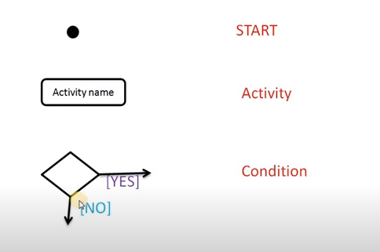
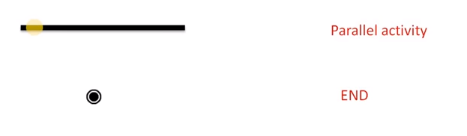
Key parts of Activity Diagram

Slide 7
h
One important point should be clearly understood that an activity diagram cannot be exactly matched with the code. The activity diagram is made to understand the flow of activities and mainly used by the business users.

Slide 8
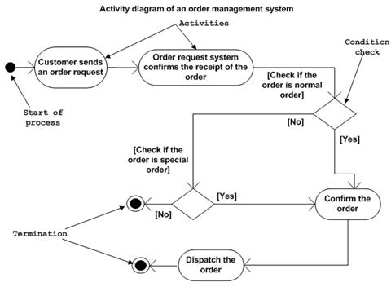
Activity diagram for order management system

Slide 9
Activity diagram for order management system
In the diagram four activities are identified which are associated with conditions.
Send order by the customer
Receipt of the order
Confirm order
Dispatch order
After receiving the order request condition checks are performed to check if it is normal or special order. After the type of order is identified dispatch activity is performed and that is marked as the termination of the process.

Slide 10
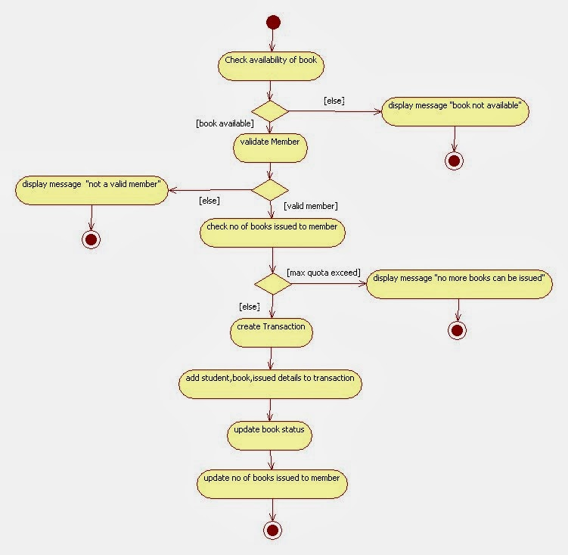
Activity diagram for Book Issue

Slide 11
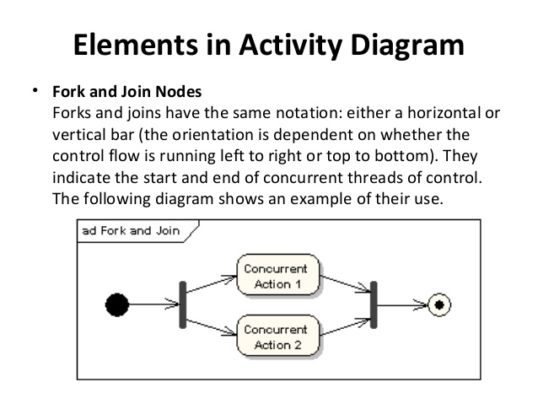
Fork and Join

Slide 12
